Slide 1
Sass
Syntactically Awesome Style Sheets

Slide 2
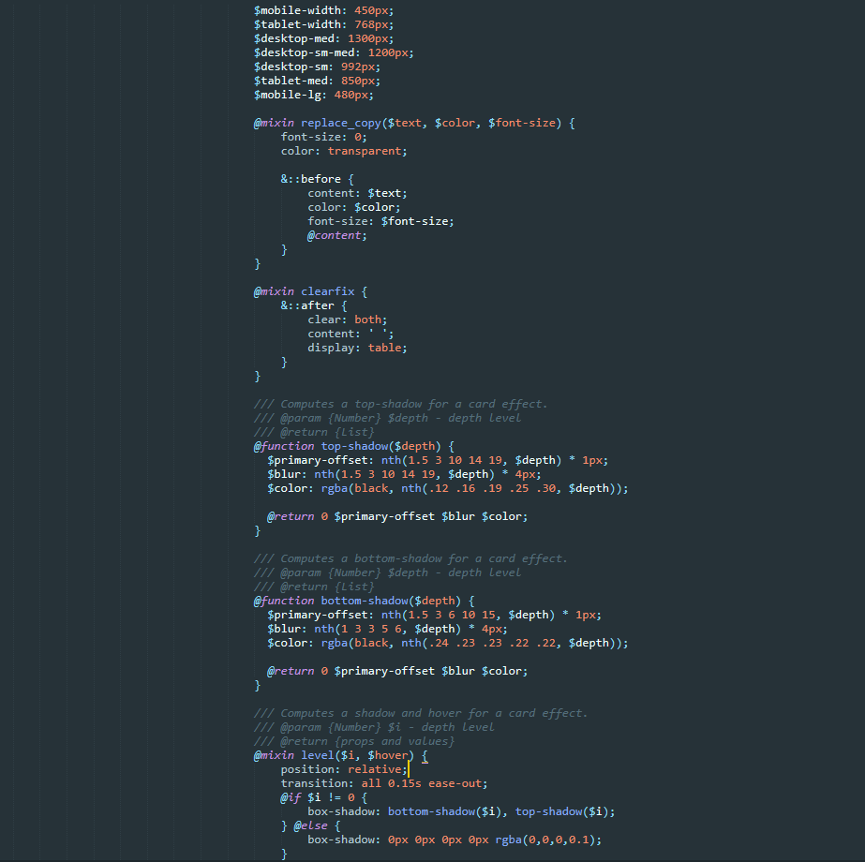
What is Sass?
“CSS with superpowers” – Sass Team
“CSS with Sass” – Someone (probably)

Slide 3

If you ask me if I think CSS pre-processors are worth learning, incorporating into your workflow, and what my favourite is, I'd tell you: yes, yes, and Sass with Compass. - Chris Coyier -

Slide 4
What is it?
Sass is the most mature, stable, and powerful professional grade CSS extension language in the world.
CSS Compatible
Sass is completely compatible with all versions of CSS, allowing you to seamlessly use any available CSS libraries.
Feature Rich
Sass boasts more features and abilities than any other CSS extension language out there.
Mature
Sass has been actively supported for over 12 years!
Industry Approved
Sass has steadily become an industry standard with many job specs listing Sass as either a desirable skill or requirement of the role.

Slide 5
Nesting

Slide 6
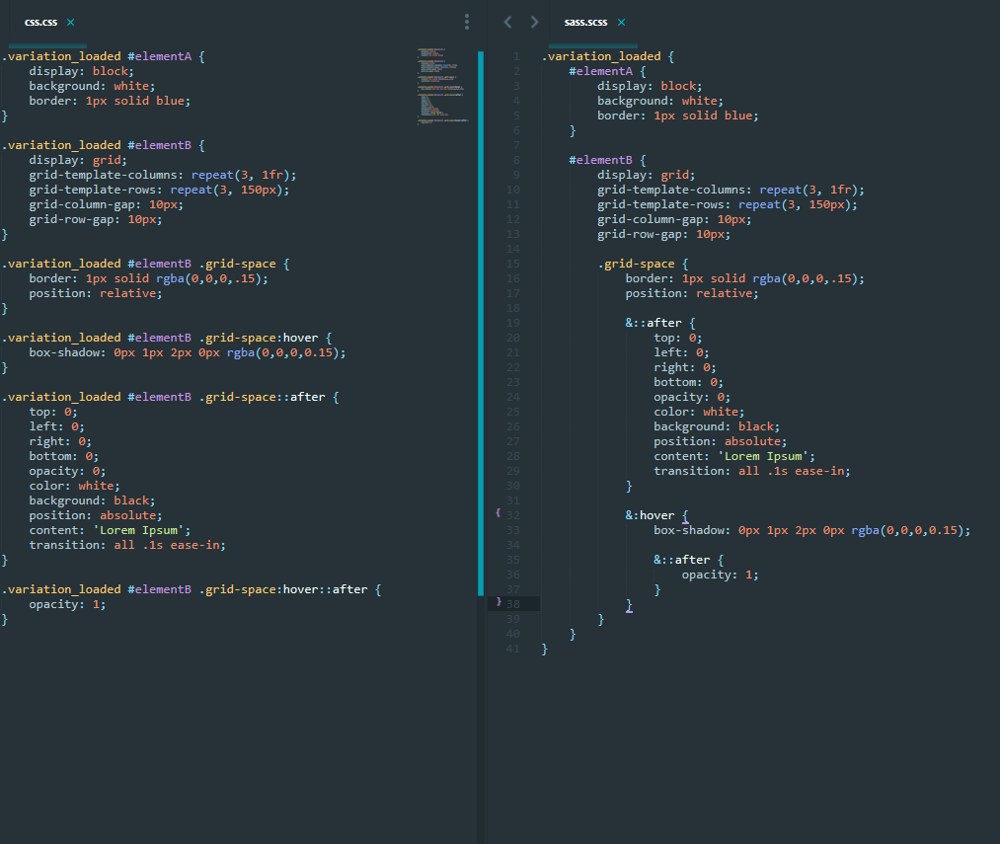
Nesting
Nesting is the most useful feature in SASS.
It allows you to easily group styles together, without having to duplicate selectors.

Slide 7
Variables

Slide 8
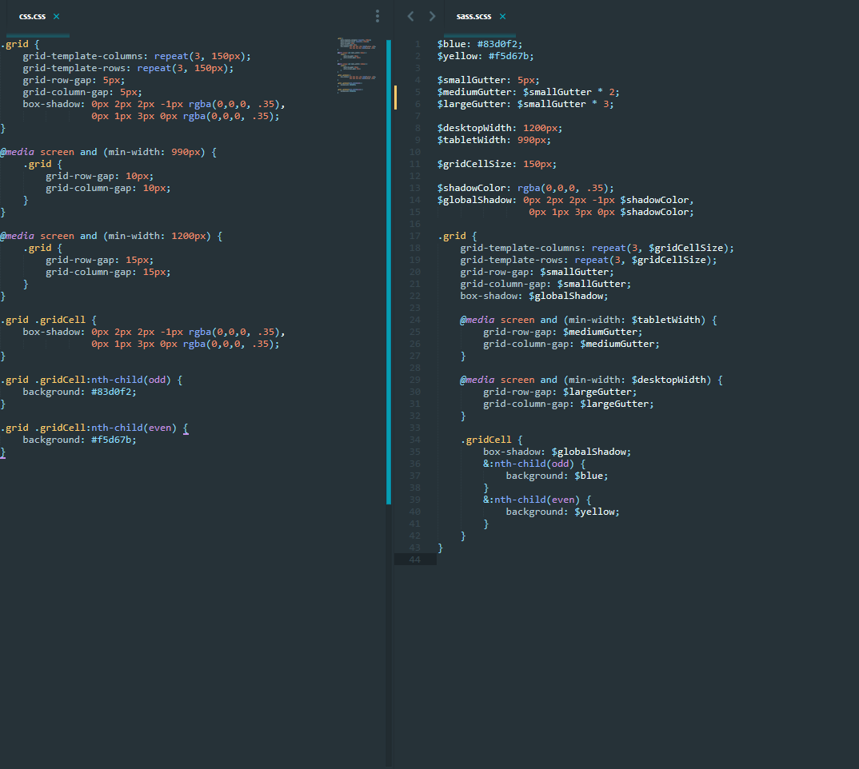
Variables
Keeps your CSS DRY
Ensures consistency throughout the project
Saves time when writing styles that are a PITA (text/box shadows)
More manageable when changing common styles such as:
font-family
box-shadow
Media query breakpoints
Brand colours

Slide 9
Extensions

Slide 10
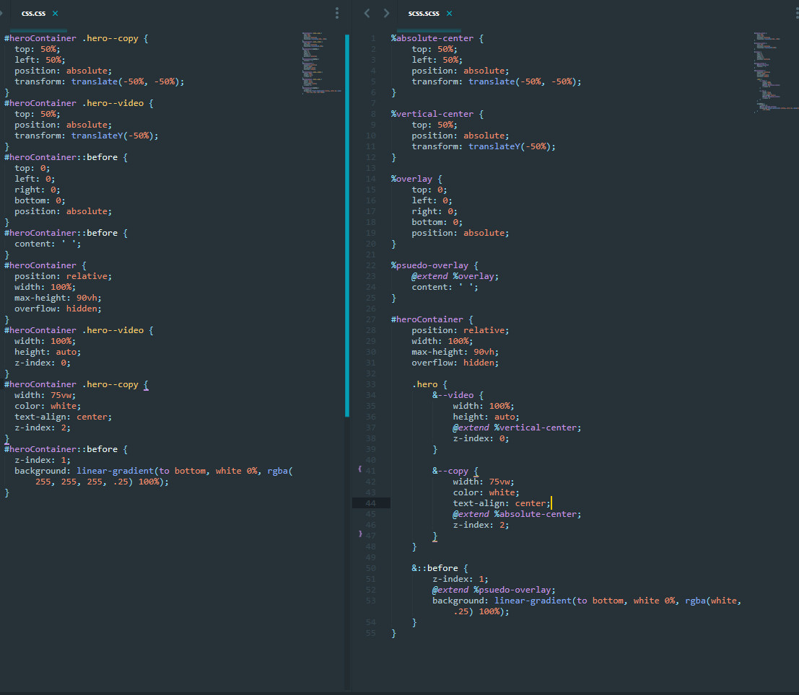
Extensions
Keeps your CSS DRY
Ensures consistency throughout the project
Saves time when writing common style patterns, such as absolutely positioning elements.

Slide 11
Mixins

Slide 12
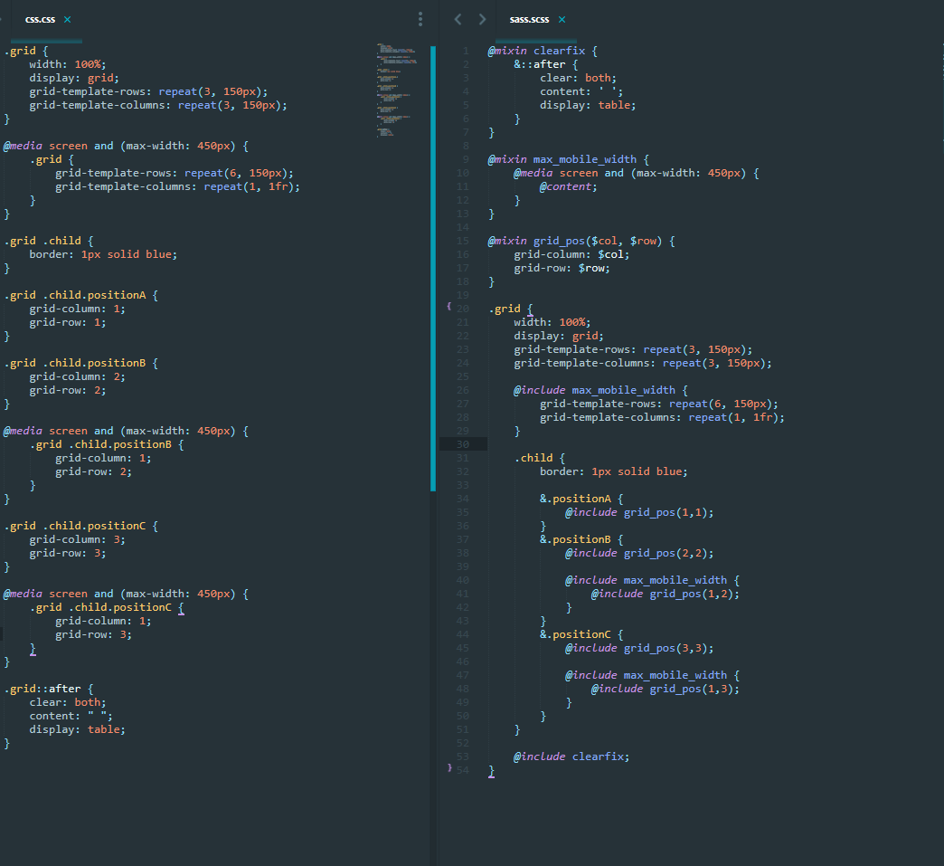
Mixins
Keeps your CSS DRY
Ensures consistency throughout the project
Saves time when writing common style patterns that have slight deviations, such as:
Media queries
Grid positioning

Slide 13
Conditionals & Loops

Slide 14
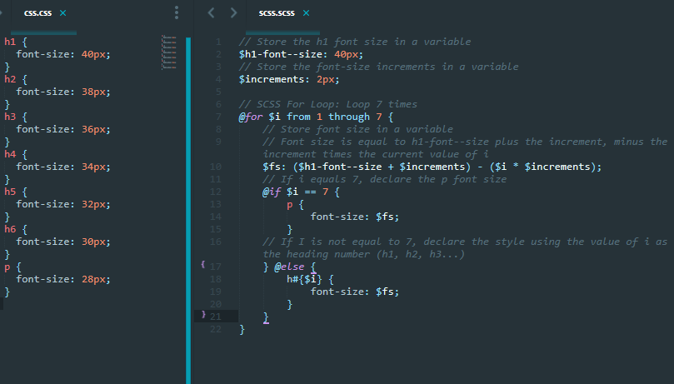
Conditionals & Loops
Keeps your CSS DRY
Saves time on writing repetitive CSS

Slide 15
Workshop
(Do It Yourself Time)

